Slide 1
EMBRACE Project Presentation
Name of presenter
Name of event / purpose of presentation
Date | Place

Slide 2
The EMBRACE Challenge:
Biotoxin threat response
Biotoxins are to be considered a very special class of threats.
The crisis management approach needs to be unconventional and ever evolving, developing specialised detection, protection, and response measures.
The EMBRACE research and innovation action investigates and validates concrete solutions of multiple nature.

Slide 3
The Objectives of EMBRACE
Strengthen European capacity for biotoxin crisis management
Increase Europe’s preparedness through science-based solutions
that address gaps in current approaches
Develop and deploy innovative field tools –including portable diagnostics, secure sampling methods, improved PPE and novel decontaminants– for rapid response in emergencies
Enable cross-border interoperability
Establish a permanent forum to generate long-term impact and an active stakeholder community
Address biotoxin resilience needs by delivering scientific insights and technological, operational and policy support

Slide 4
The EMBRACE outcomes and its stakeholders
Researchers: are given access to new tools and data
Policymakers and standardisation bodies: receive evidence-based insights and suggestions for regulatory pathways
Industry: is provided new technological solutions for new products
Biotoxin incident responders: better training, equipment, and procedures for operations
Civil society and citizens: information and a Guide to facing a Biotoxin Event

Slide 5
Tangible Goals
Biotoxin incident response requirements. Requirements for a European biotoxin incident response capacity modelling realistic scenarios and working with end users
Rapid field diagnostics. Portable devices for rapid on-site field diagnostics and detection
Propose regulatory and standardisation roadmaps, addressed alongside scientific and technological development, to incorporate into Europe’s disaster resilience framework
Forensic Guidelines. Harmonised guidelines for forensic analysis of biotoxins
Safety recommendations. Field and Lab tested specifications for new protective equipment, decontamination methods, and detection devices
Harmonised operational approaches. Standardised approaches to promote safety and interoperability in Europe
Europe-wide accessible expertise. A trusted, comprehensive source of advice and information on biotoxins

Slide 6
EMBRACE Outputs
The Biotoxin Task Force
A European Enhanced response capacity: revised CONOPs, new training materials, and specifications
Secure, legally valid sampling procedures and agreed analytical procedures
Protection and decontamination: laboratory and field-tested technological solutions and measures
Portable sampling and detection: new portable devices for breath sampling, and biotoxin field detection and analytics
Biomarkers: new methods for identifying human biomarkers of biotoxin intoxication and individual differences in susceptibility
Biothreat risk tools: New tools for biothreat risk assessment
A regulatory policy and standardisation roadmap

Slide 7
The Three Trials
Tabletop trial (TTX), targeting scientific, technological and operational actions over an extended time frame, which would be difficult to manage in field trials
Field trial (FTX1), simulating a bioterrorist attack in an airport (Limoges, FR)
Field trial (FTX2), simulating a biotoxin attack in a train tunnel (Am Berg, OS)
Trials are designed to simulate the effects of different toxins and complicating external factors

Slide 8
The EMBRACE Sustainability
The Biotoxin Task Force will sustain expertise and provide guidance beyond the project, while a regulatory and standardisation roadmap will ensure integration of EMBRACE innovations into European practice.
Together, these outcomes will strengthen Europe’s ability to anticipate, respond to, and recover from biotoxin incidents, reinforcing civil protection and resilience at every level.

Slide 9
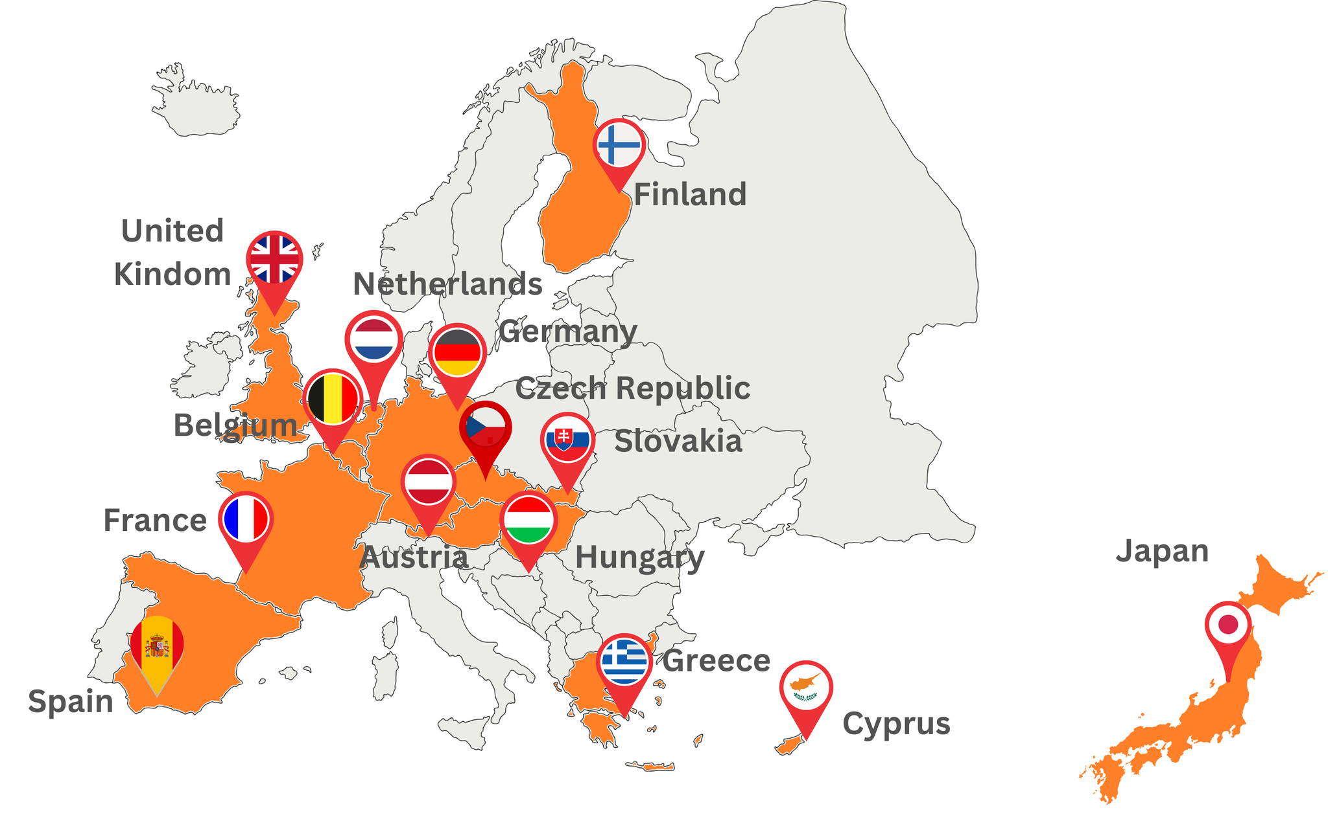
Consortium
18 partners
14 countries

Slide 10
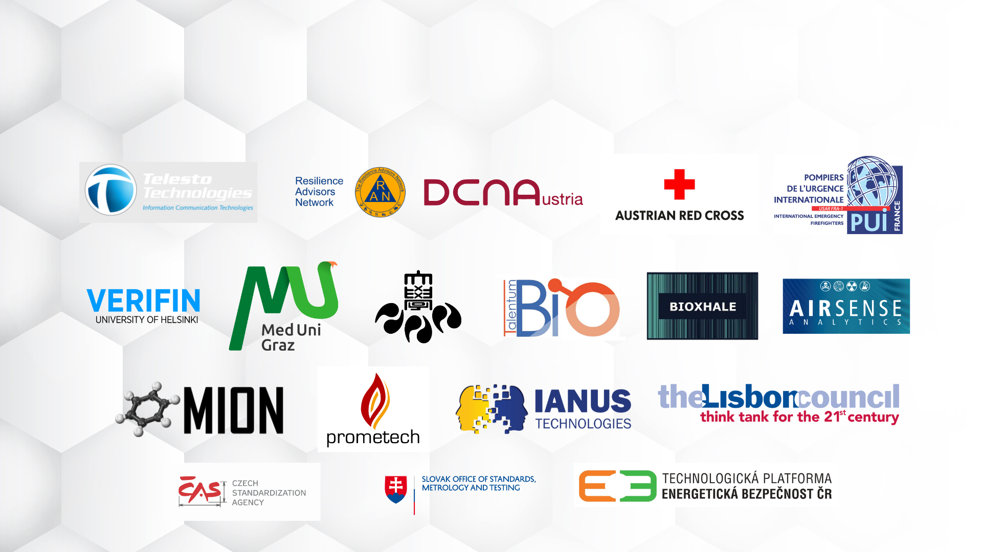
Partners
EMBRACE, coordinated by Telesto Technologies, has a consortium of 18 partners. From first responder organisations to medical and forensic laboratories, high-tech biolabs to cutting edge technologies, underpinned by standards and policy-facing organisations, EMBRACE provides comprehensive array of crisis management, medical, scientific and technological expertise.

Slide 11
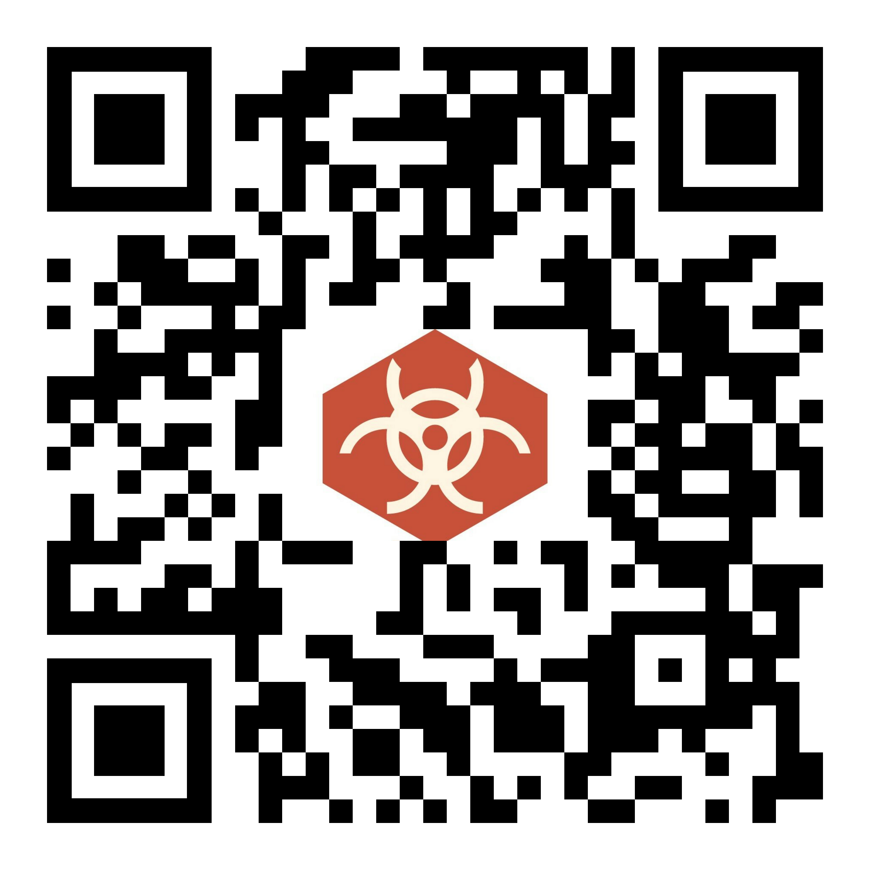
Thank you
Visit the EMBRACE website
for your attention!

